Slide 1
HSE ERS project

Slide 2

Topics
  Introduction
  Context of the project
  Project
  Modus operandi
  Discussion topics
© ERS 2013

Slide 3
Topics
  Introduction
  Context of the project
  Project
  Modus operandi
  Discussion topics
© ERS 2013

Slide 4
Buzz words
  ERS
  Semantic Interoperability in general
© ERS 2013

Slide 5
Topics
  Introduction
  Context of the project
  Project
  Modus operandi
  Discussion topics
© ERS 2013

Slide 6
Project
Buzzwords:
  EU-Context. Directives
  (Cross-border, Privacy, Medical Device)
  EIF, Base standards, etc.
  Experience in other countries (Se, AU, NL, epSOS)
© ERS 2013

Slide 7
Topics
  Introduction
  Context of the project
  Project
  Modus operandi
  Discussion topics
© ERS 2013

Slide 8
Ik denk dat zonder inhoudelijke introductie men niets begrijpt van het project plan
Daarom: Een plaatje (simpel) van de Semantic Stack:
  Encyclopedie - Ontology
  Woordenboek- Terminology SNOMED-CT
  Phrases - Archtypes/Templates (ook dit moet worden uitgelegd met een plaatje)
  Syntaxe - Reference Models
Ook is het noodzakelijk duidelijk te maken wat een Data Dictionary is
© ERS 2013

Slide 9
Project
Buzzwords:
  Goals
  Requirements
© ERS 2013

Slide 10

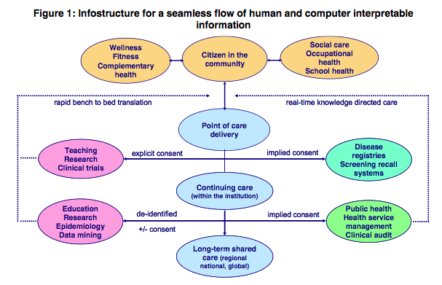
Developments
24
© copyright ERS 2012
SemanticHealthNet

Slide 11
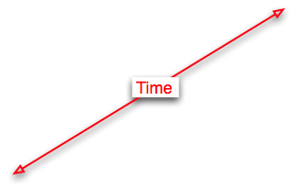
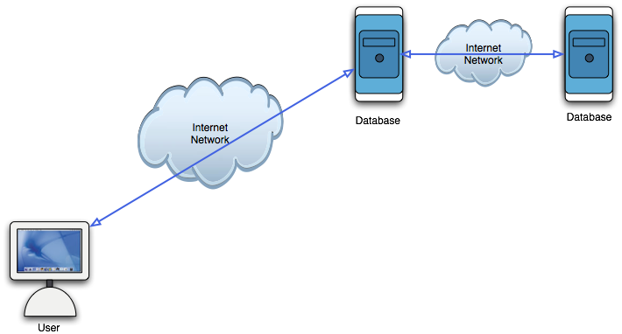
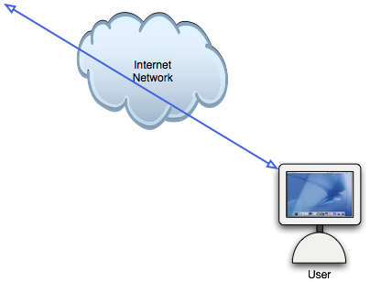




Interoperability
Common
INFOstructure
Structured/Codes
or Free text
26
© copyright ERS 2012

Slide 12


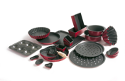



Bakery
Instructions
Ingredients
Moulds
Kitchen
machines
Oven
Pastry
28
© copyright ERS 2012
Notes:
A Metaphor will be used
- Components needed to produce Pastries

Slide 13





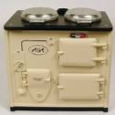
Bakery/EHR expectations
Instructions
Ingredients
Moulds
Kitchen
machines
Oven
Pastry
Rules
Information
Presentation
Software
Hardware
EHR
29
© copyright ERS 2012
Notes:
Different Instructions and ingredients make an other type of pastry
The same Instructions used in a different setting produce the same pastry
Metaphor
- Instructions = Business Rules
- Ingredients = Information
- Moulds = Presentation
- Kitchen machinery = Software
- Oven = Hardware

Slide 14
EHR’s now
Instructions
Ingredients
Moulds
Kitchen
machines
Oven
Pastry
Rules
Information
Presentation
Software
Hardware
EHR
30
© copyright ERS 2012
Notes:
Each IT-vendor delivers a unique (proprietary) system with limited possibilities to adapt to local needs
Rules, Information, Moulds, Machines, and the Oven can not be exchanged.
Each IT-system has proprietary solutions that can not be exchanged

Slide 15
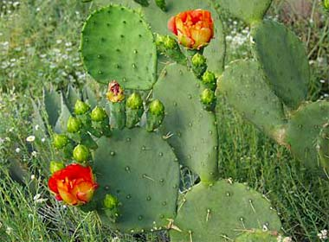
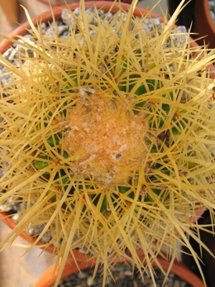
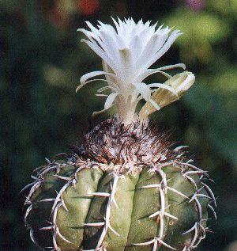
EHR systems now
31
© copyright ERS 2012
Notes:
Consequence:
Each selects a nice flower and has to live with the not so nice consequences.

Slide 16
EHR-systems we need
Instruction
Ingredients
Moulds
Kitchen tools
Oven
Pastry
Rules
Information
Presentation
Software
Hardware
EHR
32
© ERS 2012
Notes:
The baker in his bakery is able to exchange all component.
What we need in healthcare is that healthcare providers and organisations can select the components freely.
No more proprietary solutions.
And an absolute separation between Healthcare and the IT-world.
What ever healthcare defines in terms of Instructions (Rules), Ingredients (information), and Moulds (Presentation) the IT-world can deal with it without reprogramming and database conversions.
Any set of Rules, any set of Information, any presentation spec, can be executed by all IT-systems.

Slide 17

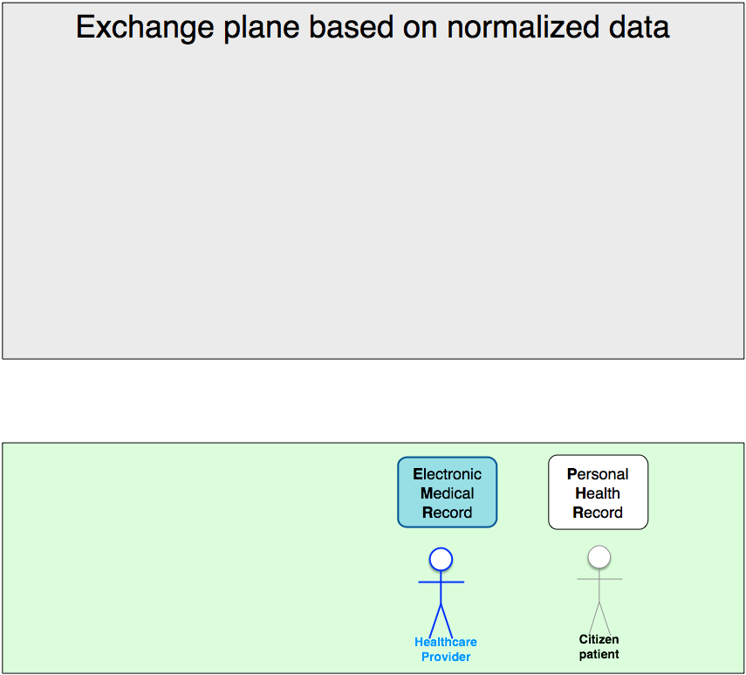
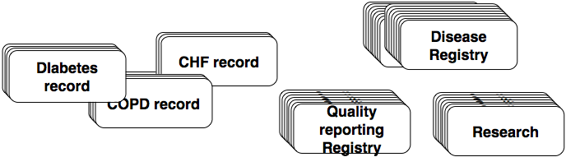
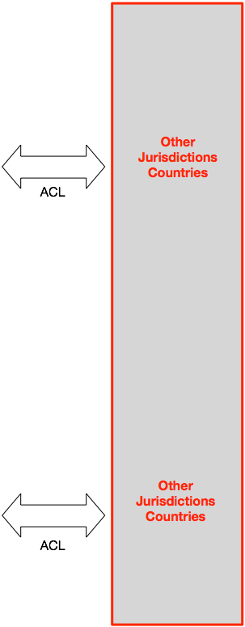







EHR Functional Model

Slide 18
EHR Functional Model
Success factors
Standards based
neutral
supporting services
By all, for all
Standardised data and
Flexibility
adaptablity
Healthcare provider and Patient jointly are responsible for privacy
Each Patient can be an AUTHOR
Each AUTHOR
is
accountable
for Content and Privay

Slide 19
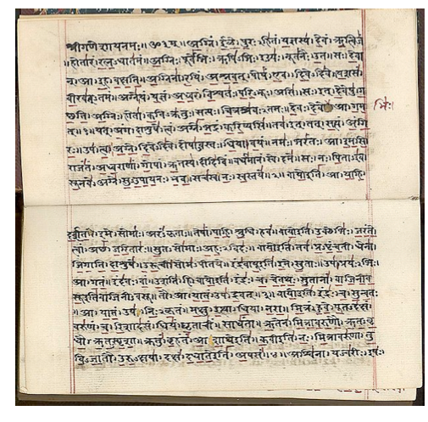
Semantic Stack
What do we need to know in order to communicate?
  Characters
  Language
  Syntax
  Phrases
  Words
  Knowledge
Implicit-
ness
Explicit-
ness
© ERS 2012

Slide 20
Semantic Stack
What do we need to know in order to communicate?
And that is not all.
We need to know:
  What
  Where
  Why
  Who
  How
© ERS 2012

Slide 21














Semantic stack

Slide 22
Modus operandi
Requirements:
  Generic (eHealth Strategy Ireland, 2013): What eHealth Delivers (4)
    empower patient (and healthcare provider/author)
    focus on care process
    safe, secure, high quality service
    Flexible adaptable to individual care needs
    evolution
    ROI: effective, efficient
    supporting industry
© ERS 2013

Slide 23
HSE
LOT 4 INFORMATION ARCHITECTURE
Part 1: Information Architecture
Part 2: Data Dictionary
Part 3: Terminology
Part 4: Operations (Governance)
© ERS 2013

Slide 24
Part 1
Determination of the Information Model
  Establish suitable standards based Information Architecture Reference Model (IA-RM)
  The provision of a standards based subject area model (SAM)
  The determination of which technical systems should participate in the subject area model (SAM)
  Recommendation of a Governance Framework and Tooling for Model maintenance and expansion
  A catalogue with the Standards and associated sub-sections for the Model
© ERS 2013

Slide 25
Part 2
Data Dictionary
  The determination of a Standards Based Data Dictionary including the specification of meta data structure, data classes, entities and attributes
  Validation (Proof-of-Concept) of the Data Dictionary
  Recommendation of a Governance Framework and Tooling for Dictionary maintenance and expansion
  A catalogue with the Standards and associated sub-sections for the Dictionary
© ERS 2013

Slide 26
Part 3
Terminology Assurance
  Provision of a blueprint for the deployment, management and maintenance of the terminology service
  Validation of the proposed model thought the binding of SNOMED CT concepts to a specified clinical data set
  A catalogue with the Standards and linkages associated with its operation and maintenance
© ERS 2013

Slide 27
Part 4
Support Process and Services
  What standards based toolsets and support structure are required and available to manage the collective practical outputs and relationships of the information components listed above
  A brief comparison of the products that best meet this need including commercial and open source toolsets
  The recommendation of an established toolset and management approach to facilitate integrated governance of the data model, data dictionary and terminology service
© ERS 2013

Slide 28
Topics
  Introduction
  Context of the project
  Project
  Modus operandi
  Discussion topics
© ERS 2013

Slide 29
Modus operandi
Buzzwords:
  Project time lines: Demonstration + deliverables
  Stakeholder groups, Review group
  Requirements
  Evolution
  Questionnaires
  1-1 Update sessions when needed
  Each meeting in Dublin and TelCon: evaluate stakeholder attendance
© ERS 2013

Slide 30
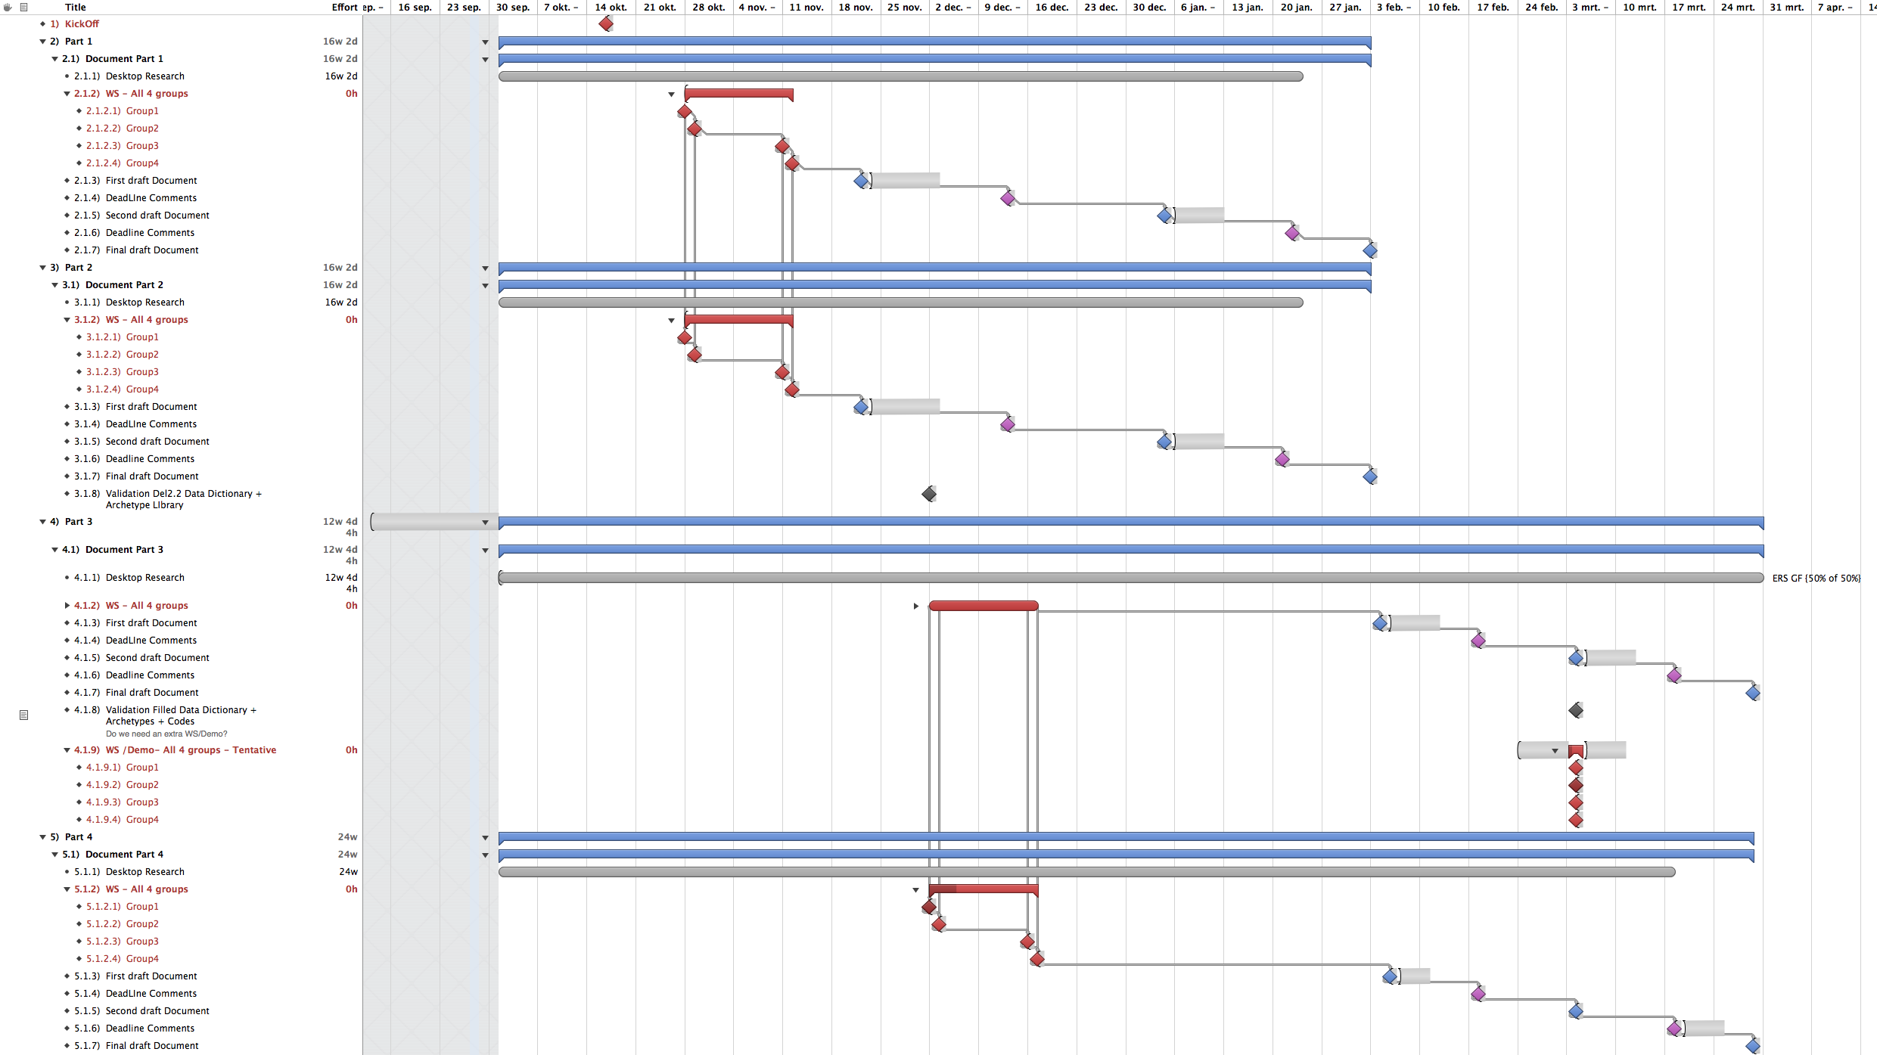

Slide 31
Topics
  Introduction
  Context of the project
  Project
  Modus operandi
  Discussion topics
© ERS 2013

Slide 32
Discussion topics
Buzzwords:
© ERS 2013

Slide 33
Questions
  Is there a specified format for the Deliverables?
  Do we have to base all proposed solutions on requirements as specified by: Irish and EU documents plus international standards?
  Can you agree with the EHR/EMRPHR high level Functional model?
  Can we agree about the Semantic stack?
  And about the components of the Infostructure Toolbox?
  What Irish back-ground documents need to be read/analised?
  What International documents (Directives, NEHTA-AU, ...)
  Are the terms Semantic Interoperability Artefact and Semantic Interoperability Toolbox descriptive enough?
© ERS 2013

Slide 34
Questions
  What do you see for your sector the major benefits?
  What do you see for your sector the major obstacles?
  What about other stakeholders (HcProviders, their organisations, and IT-depatrments plus IT-vendors)?
  Is there any advice about known sensitivities with these stakeholders?
© ERS 2013

